Slide 1
Inference in First-Order Logic

Slide 2
Outline
Reducing first-order inference to propositional inference
Unification
Lifted Resolution

Slide 3
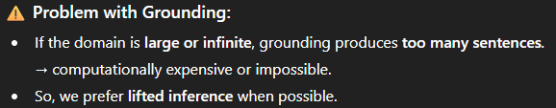
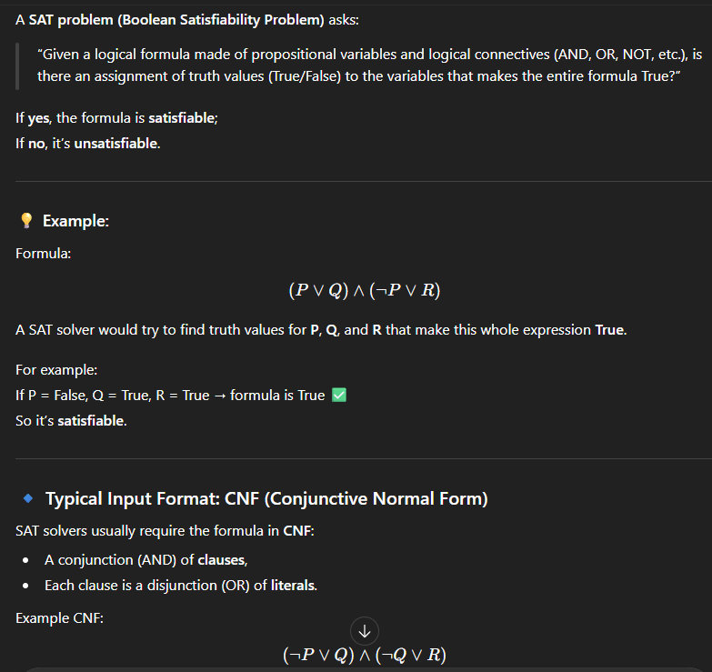
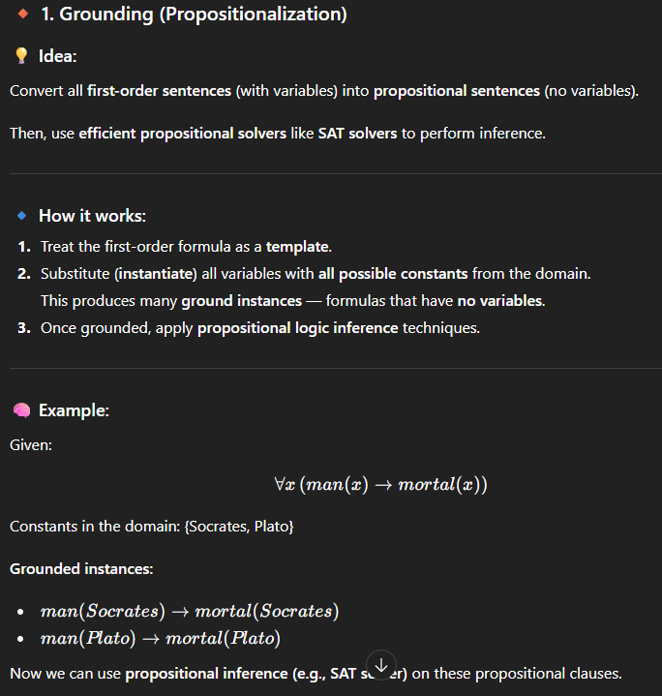
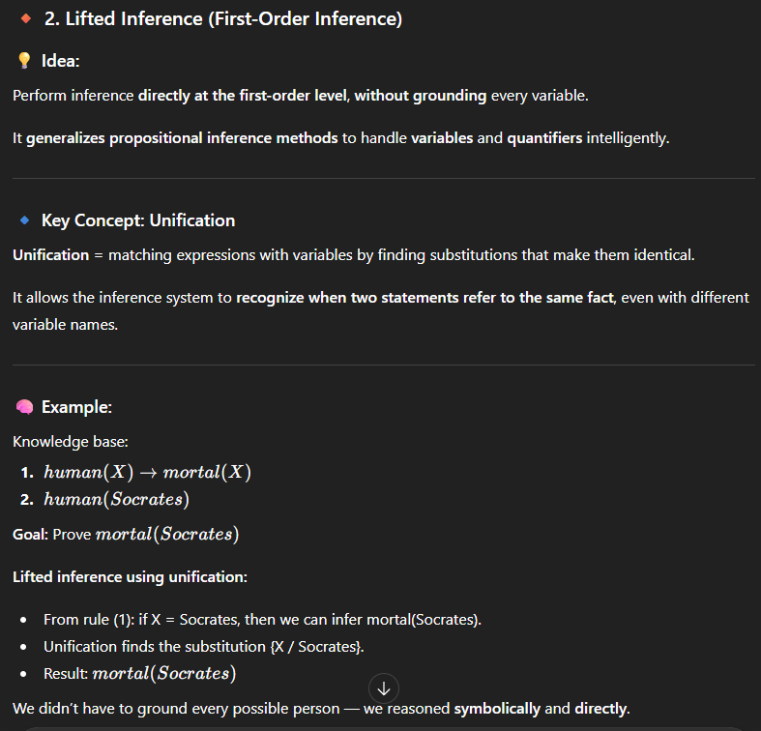
Two Basic Ideas for Inference in FOL
Grounding:
  Treat first-order sentences as a template.
  Instantiating all variables with all possible constants gives a set of ground propositional clauses.
  Apply efficient propositional solvers, e.g. SAT.
Lifted Inference:
  Generalize propositional methods for 1st-order methods.
  Unification: recognize instances of variables where necessary.

Slide 4
Universal instantiation (UI)
Notation: Subst({v/g}, α) means the result of substituting g for v in sentence α
Every instantiation of a universally quantified sentence is entailed by it:
∀v α
Subst({v/g}, α)
for any variable v and ground term g
E.g., ∀x King(x) ∧ Greedy(x) ⇒ Evil(x) yields
  King(John) ∧ Greedy(John) ⇒ Evil(John), {x/John}
  King(Richard) ∧ Greedy(Richard) ⇒ Evil(Richard), {x/Richard}
  King(Father(John)) ∧ Greedy(Father(John)) ⇒ Evil(Father(John)), {x/Father(John)}

Slide 5
Existential instantiation (EI)
For any sentence α, variable v, and constant symbol k (that does not appear elsewhere in the knowledge base):
∃v α
Subst({v/k}, α)
E.g., ∃x Crown(x) ∧ OnHead(x,John) yields: Crown(C₁) ∧ OnHead(C₁,John)
where C₁ is a new constant symbol, called a Skolem constant
Existential and universal instantiation allows to “propositionalize” any FOL sentence or KB
  EI produces one instantiation per EQ sentence
  UI produces a whole set of instantiated sentences per UQ sentence

Slide 6
Reduction to propositional form
Suppose the KB contains the following:
  ∀x King(x) ∧ Greedy(x) ⇒ Evil(x)
  Father(x)
  King(John)
  Greedy(John)
  Brother(Richard,John)
Instantiating the universal sentence in all possible ways, we have:
  King(John) ∧ Greedy(John) ⇒ Evil(John)
  King(Richard) ∧ Greedy(Richard) ⇒ Evil(Richard)
  King(John)
  Greedy(John)
  Brother(Richard,John)
The new KB is propositionalized: propositional symbols are
  King(John), Greedy(John), Evil(John), King(Richard), etc

Slide 7
Reduction continued
Every FOL KB can be propositionalized so as to preserve entailment
  A ground sentence is entailed by new KB iff entailed by original KB
Idea for doing inference in FOL:
  propositionalize KB and query
  apply resolution-based inference
  return result
Problem: with function symbols, there are infinitely many ground terms,
  e.g., Father(Father(Father(John))), etc

Slide 8
Issues with Propositionalization
Problem: works if α is entailed, loops if α is not entailed
Propositionalization generates lots of irrelevant sentences
  So inference may be very inefficient. E.g., consider KB
  ∀x King(x) ∧ Greedy(x) ⇒ Evil(x)
  King(John)
  ∀y Greedy(y)
  Brother(Richard,John)
  It seems obvious that Evil(John) is entailed, but propositionalization produces lots of facts such as Greedy(Richard) that are irrelevant.
  Approach: Magic Set Rewriting, from deductive databases.
With p k-ary predicates and n constants, there are p·n^{k} instantiations.
  Current Research, Mitchell and Ternovska SFU.
Alternative: do inference directly with FOL sentences

Slide 9
Unification
Recall: Subst(θ, p) = result of substituting θ into sentence p
Unify algorithm: takes 2 sentences p and q and returns a unifier if one exists
Unify(p,q) = θ where Subst(θ, p) = Subst(θ, q)
Example:
p = Knows(John,x)
q = Knows(John, Jane)
Unify(p,q) = {x/Jane}

Slide 10
Unification examples
simple example: query = Knows(John,x), i.e., who does John know?
p q θ
Knows(John,x) Knows(John,Jane) {x/Jane}
Knows(John,x) Knows(y,OJ) {x/OJ,y/John}
Knows(John,x) Knows(y,Mother(y)) {y/John,x/Mother(John)}
Knows(John,x) Knows(x,OJ) {fail}
Last unification fails: only because x can’t take values John and OJ at the same time
Problem is due to use of same variable x in both sentences
Simple solution: Standardizing apart eliminates overlap of variables, e.g., Knows(z,OJ)

Slide 11
Unification
To unify Knows(John,x) and Knows(y,z),
θ = {y/John, x/z } or θ = {y/John, x/John, z/John}
The first unifier is more general than the second.
Theorem: There is a single most general unifier (MGU) that is unique up to renaming of variables.
  MGU = { y/John, x/z }
General algorithm in Figure 9.1 in the text

Slide 12
Recall our example…
  King(John)
  ∀y Greedy(y)
  Brother(Richard,John)
  We would like to infer Evil(John) without propositionalization.
  Basic Idea: Use Modus Ponens, Resolution when literals unify.
x King(x)  Greedy(x)  Evil(x)

Slide 13
Generalized Modus Ponens (GMP)
p₁', p₂', … , p_{n}', ( p₁ ∧ p₂ ∧ … ∧ p_{n} ⇒q)
Subst(θ,q)
Example:
p₁' is King(John) p₁ is King(x)
p₂' is Greedy(John) p₂ is Greedy(x)
θ is {x/John} q is Evil(x)
Subst(θ,q) is Evil(John)
King(John), Greedy(John) ,x King(x)  Greedy(x)  Evil(x)
where we can unify p_{i}‘ and p_{i} for all i
Evil(John)

Slide 14
Completeness and Soundness of GMP
GMP is sound
  Only derives sentences that are logically entailed
  See proof in Ch.9.5.4. of the text.
GMP is complete for a 1st-order KB in Horn Clause format.
  Complete: derives all sentences that entailed.

Slide 15
Resolution in FOL
Full first-order version:
l₁ ∨ ··· ∨ l_{k}, m₁ ∨ ··· ∨ m_{n}
Subst(θ , l₁ ∨ ··· ∨ l_{i-1} ∨ l_{i+1} ∨ ··· ∨ l_{k} ∨ m₁ ∨ ··· ∨ m_{j-1} ∨ m_{j+1} ∨ ··· ∨ m_{n})
where Unify(l_{i}, ¬m_{j}) = θ.
The two clauses are assumed to be standardized apart so that they share no variables.
For example,
¬Rich(x) ∨ Unhappy(x) Rich(Ken)
Unhappy(Ken)
with θ = {x/Ken}
Apply resolution steps to CNF(KB ∧ ¬α); complete for FOL.
  Gödel’s completeness theorem.

Slide 16
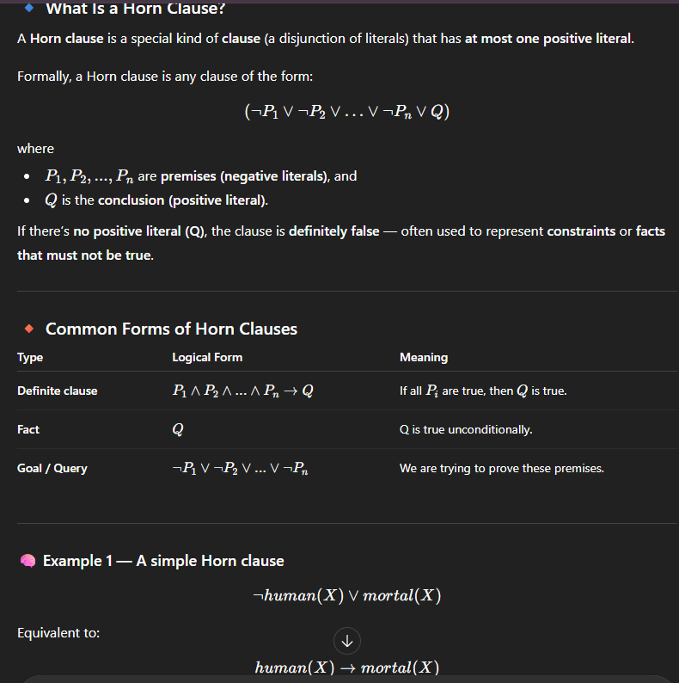



Horn Clauses
Resolution in general can be exponential in space and time.
If we can reduce all clauses to “Horn clauses” resolution is linear in space and time
A clause with at most 1 positive literal.
e.g.
Every Horn clause can be rewritten as an implication with
a conjunction of positive literals in the premises and a single
positive literal as a conclusion.
e.g.
1 positive literal: definite clause
0 positive literals: Fact or integrity constraint:
e.g.

Slide 17
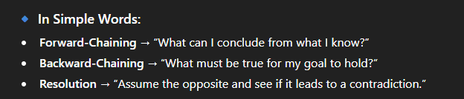
Inference appoaches in FOL
Forward-chaining
  Uses GMP (generalized modus ponens) to add new atomic sentences
  Useful for systems that make inferences as information streams in
  Requires KB to be in form of first-order definite clauses
Backward-chaining
  Works backwards from a query to try to construct a proof
  Can suffer from repeated states and incompleteness
  Useful for query-driven inference
Resolution-based inference (FOL)
  Refutation-complete for general KB
    Can be used to confirm or refute a sentence p (but not to generate all entailed sentences)
  Requires FOL KB to be reduced to CNF
  Uses generalized version of propositional inference rule
Note that all of these methods are generalizations of their propositional equivalents

Slide 18
Knowledge Base in FOL
The law says that it is a crime for an American to sell weapons to hostile nations. The country Nono, an enemy of America, has some missiles, and all of its missiles were sold to it by Colonel West, who is American.
Exercise: Formulate this knowledge in FOL.

Slide 19
Knowledge Base in FOL
The law says that it is a crime for an American to sell weapons to hostile nations. The country Nono, an enemy of America, has some missiles, and all of its missiles were sold to it by Colonel West, who is American.
... it is a crime for an American to sell weapons to hostile nations:
  American(x) ∧ Weapon(y) ∧ Sells(x,y,z) ∧ Hostile(z) ⇒ Criminal(x)
Nono … has some missiles, i.e., ∃x Owns(Nono,x) ∧ Missile(x):
Owns(Nono,M₁) and Missile(M₁)
… all of its missiles were sold to it by Colonel West
  Missile(x) ∧ Owns(Nono,x) ⇒ Sells(West,x,Nono)
Missiles are weapons:
An enemy of America counts as "hostile“:
Enemy(x,America) ⇒ Hostile(x)
West, who is American …
American(West)
The country Nono, an enemy of America …
Enemy(Nono,America)
Missile(x)  Weapon(x)

Slide 20
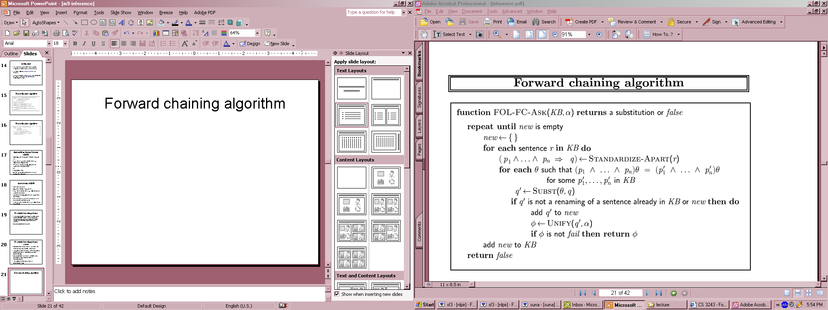
Forward chaining algorithm
Definite clauses → disjunctions of literals of which exactly one is positive.
  P1 , p2, p3 → q
Is suitable for using GMP

Slide 21
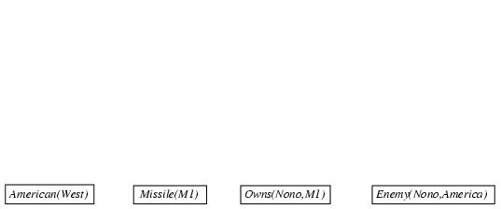
Forward chaining proof

Slide 22
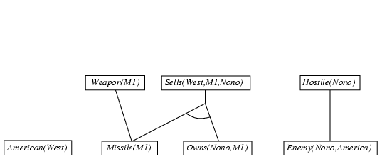
Forward chaining proof

Slide 23
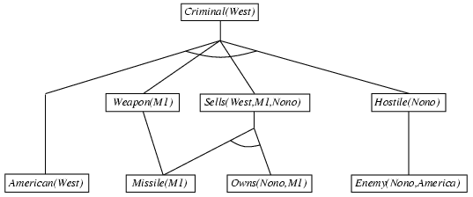
Forward chaining proof

Slide 24
Properties of forward chaining
Sound and complete for first-order definite clauses
Datalog = first-order definite clauses + no functions
FC terminates for Datalog in finite number of iterations
May not terminate in general if α is not entailed

Slide 25
Efficiency of forward chaining
Incremental forward chaining: no need to match a rule on iteration k if a premise wasn't added on iteration k-1
  ⇒ match each rule whose premise contains a newly added positive literal
Matching itself can be expensive:
Database indexing allows O(1) retrieval of known facts
  e.g., query Missile(x) retrieves Missile(M₁)
Forward chaining is widely used in deductive databases

Slide 26
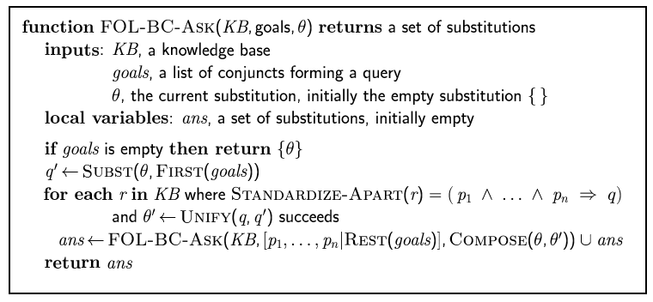
Backward chaining algorithm

Slide 27

Backward chaining example

Slide 28
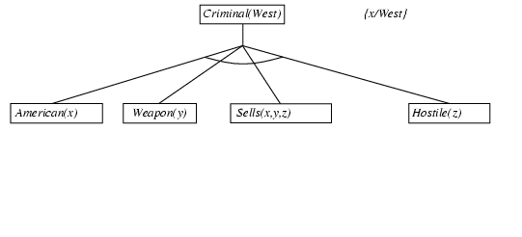
Backward chaining example

Slide 29
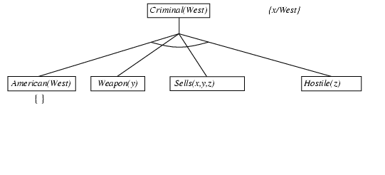
Backward chaining example

Slide 30
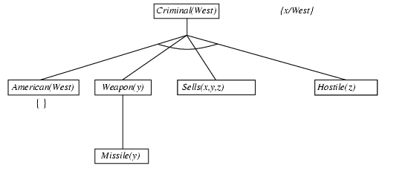
Backward chaining example

Slide 31
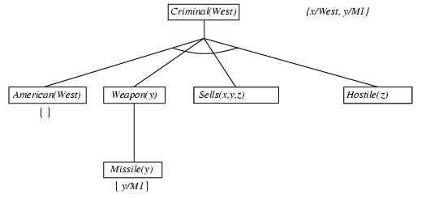
Backward chaining example

Slide 32
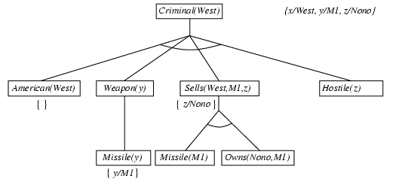
Backward chaining example

Slide 33
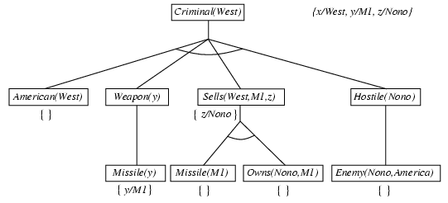
Backward chaining example

Slide 34
Backward chaining example

Slide 35
Properties of backward chaining
Depth-first recursive proof search: space is linear in size of proof
Incomplete due to infinite loops
  ⇒ fix by checking current goal against every goal on stack
Inefficient due to repeated subgoals (both success and failure)
  ⇒ fix using caching of previous results (extra space)
Widely used for logic programming

Slide 36
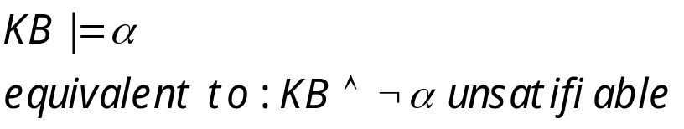

Recall: Propositional Resolution-based Inference
We want to prove:
We first rewrite into conjunctive normal form (CNF).
literals
A “conjunction of disjunctions”
(A ∨ ¬B) ∧ (B ∨ ¬C ∨ ¬D)
Clause
Clause
Any KB can be converted into CNF
k-CNF: exactly k literals per clause

Slide 37
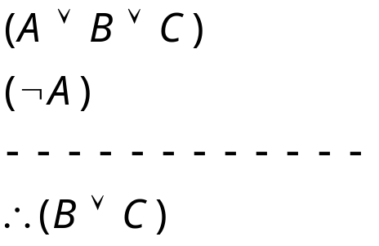
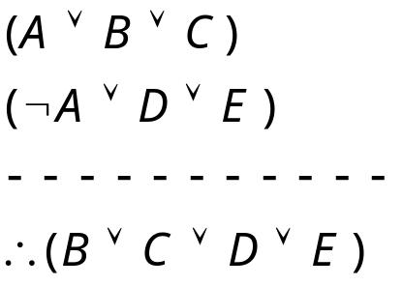
Resolution Examples (Propositional)

Slide 38
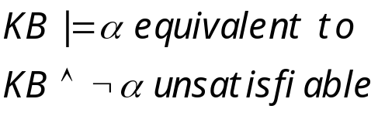


Resolution Algorithm
The resolution algorithm tries to prove:
Generate all new sentences from KB and the query.
One of two things can happen:
We find which is unsatisfiable,
i.e. we can entail the query.
2. We find no contradiction: there is a model that satisfies the
  Sentence (non-trivial) and hence we cannot entail the query.

Slide 39

Resolution example
KB = (B_{1,1} ⇔ (P_{1,2}∨ P_{2,1})) ∧¬ B_{1,1}
α = ¬P_{1,2}
True
False in
all worlds

Slide 40
Example Knowledge Base in FOL (Hassan)
... it is a crime for an American to sell weapons to hostile nations:
  American(x) ∧ Weapon(y) ∧ Sells(x,y,z) ∧ Hostile(z) ⇒ Criminal(x)
Nono … has some missiles, i.e., ∃x Owns(Nono,x) ∧ Missile(x):
  Owns(Nono,M₁) and Missile(M₁)
… all of its missiles were sold to it by Colonel West
  Missile(x) ∧ Owns(Nono,x) ⇒ Sells(West,x,Nono)
Missiles are weapons:
  Missile(x) ⇒ Weapon(x)
An enemy of America counts as "hostile“:
  Enemy(x,America) ⇒ Hostile(x)
West, who is American …
  American(West)
The country Nono, an enemy of America …
  Enemy(Nono,America)
  Can be converted to CNF
  Query: Criminal(West)?
Notes:
Hassan stopped here

Slide 41
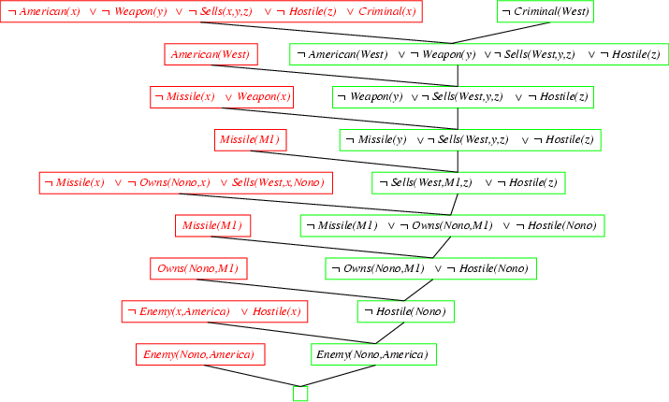
Resolution proof
Notes:
Last step is missing a negation sign on the green part.

Slide 42
Converting FOL sentences to CNF
Original sentence:
Anyone who likes all animals is loved by someone:
  ∀x [∀y Animal(y) ⇒ Likes(x,y)] ⇒ [∃y Loves(y,x)]
1. Eliminate biconditionals and implications
  ∀x [¬∀y ¬Animal(y) ∨ Likess(x,y)] ∨ [∃y Loves(y,x)]
2. Move ¬ inwards:
Recall: ¬∀x p ≡ ∃x ¬p, ¬ ∃x p ≡ ∀x ¬p
  ∀x [∃y ¬(¬Animal(y) ∨ Likes(x,y))] ∨ [∃y Loves(y,x)]
  ∀x [∃y ¬¬Animal(y) ∧ ¬Likes(x,y)] ∨ [∃y Loves(y,x)]
  ∀x [∃y Animal(y) ∧ ¬Likes(x,y)] ∨ [∃y Loves(y,x)]
  Either there is some animal that x doesn’t like if that is not the case then someone loves x

Slide 43
Conversion to CNF contd.
Standardize variables: each quantifier should use a different one
  ∀x [∃y Animal(y) ∧ ¬Likes(x,y)] ∨ [∃z Loves(z,x)]
Skolemize:
∀x [Animal(A) ∧ ¬Likes(x,A)] ∨ Loves(B,x)
  Everybody fails to love a particular animal A or is loved by a particular person B
  Animal(cat)
  Likes(marry, cat)
  Loves(john, marry)
  Likes(cathy, cat)
  Loves(Tom, cathy)
a more general form of existential instantiation.
  Each existential variable is replaced by a Skolem function of the enclosing universally quantified variables:
  ∀x [Animal(F(x)) ∧ ¬Loves(x,F(x))] ∨ Loves(G(x),x)
  (reason: animal y could be a different animal for each x.)

Slide 44
Conversion to CNF contd.
Drop universal quantifiers:
  [Animal(F(x)) ∧ ¬Loves(x,F(x))] ∨ Loves(G(x),x)
  (all remaining variables assumed to be universally quantified)
Distribute ∨ over ∧ :
  [Animal(F(x)) ∨ Loves(G(x),x)] ∧ [¬Loves(x,F(x)) ∨ Loves(G(x),x)]
  Original sentence is now in CNF form – can apply same ideas to all sentences in KB to convert into CNF
  Also need to include negated query Then use resolution to attempt to derive the empty clause which show that the query is entailed by the KB

Slide 45
Complex Skolemization Example
KB:
Everyone who loves all animals is loved by someone.
Anyone who kills animals is loved by no-one.
Jack loves all animals.
Either Curiosity or Jack killed the cat, who is named Tuna.
Query: Did Curiosity kill the cat?
Inference Procedure:
Express sentences in FOL.
Eliminate existential quantifiers.
Convert to CNF form and negated query.

Slide 46
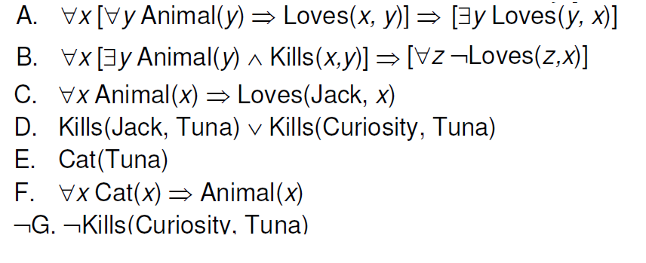

Slide 47
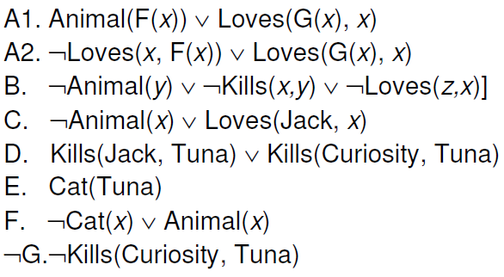
Notes:
To get A1, A2. a) skolemize first existential quantifier in consequen using G(x). Then negate implication, gives me existential in antecedent. Skolemize using f(x). Now I have conjunction from antecedent or consequent, distribute conjunction.

Slide 48
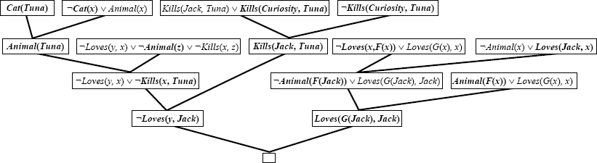
Resolution-based Inference
Notes:
Left half: just regular without skolem, basically says that if Jack did kill Tuna, then nobody loves jack.
Right side: use unification x:=jack on left, x := F(jack) on right.

Slide 49
Summary
Inference in FOL
  Grounding approach: reduce all sentences to PL and apply propositional inference techniques.
FOL/Lifted inference techniques
  Propositional techniques + Unification.
  Generalized Modus Ponens
  Resolution-based inference.
Many other aspects of FOL inference we did not discuss in class

